Slide 1
Applications of Flight Clustering as a Revenue Analytics Tool
Kofi Buahin
Yanik Lacroix Torrent

Slide 2
Agenda
Project Objective
Methodology and Assumptions
Tableau Dashboard Walk Through
Looking Forward: Implications of Project Results
Questions

Slide 3
Project Objective
Our goal with this project was to develop a flight clustering model that could fuel an alert system to detect flights which don’t follow their expected pattern, track and visualize them, and create an avenue for the Revenue analysts to take action .
SQL
R
Tableau
Cluster Model to support an Flight Exception Detection Analytical Tool

Slide 4
Project Implications – Potential Benefits
Could allow for better exception detecting capabilities for our analysts.
If fully developed, the clustering model could provide a potential replacement for Split Histories methodology.
Could enhance our capabilities to visualize flight performance and allow analysts to make more informed decisions.

Slide 5
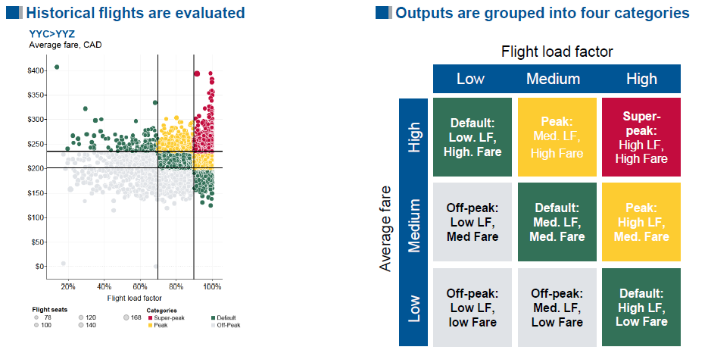
Seabury: Split History Methodology
WestJet currently has a clustering system that serves to calculate split histories for use.
Flights are clustered into 4 categories based on Load Factor and Average Fares.
Segmentation is based on a 70-90% LF threshold and average thresholds are dynamically adjusted based on a Market by Market basis.

Slide 6
Key Steps Overview
Data Extraction & Selection
Outlier Detection
Clustering Method Selection
Clustering & Review of Results
YoY Mapping and Flight Comparison

Slide 7
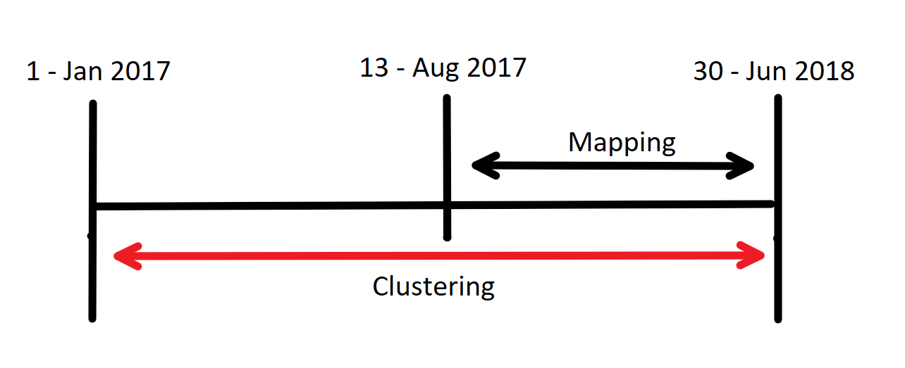


Data Extraction
Pulled day of departure flight data from between January 1st 2017 – June 30th 2018.
Collected data from two different warehouses in SQL.
Inventory Leg Build
Houses inventory data and facts about the flight
Flown Revenue
Contains only bookings information and anything pertaining to price & Revenue

Slide 8
Data Selection – Key Variables & KPIs Collected
Variable/KPI | Data Source | Reason for Selection
Directional Market | Inventory Leg Build | Flight Data Identification & Grouping
Flight Number | Inventory Leg Build | Flight Data Identification
Capture Date | Inventory Leg Build | Flight Data Identification & YoY Mapping
Flight Date | Inventory Leg Build | Flight Data Identification & YoY Mapping
Departure Time | Inventory Leg Build | YoY Mapping
RPM & ASM | Inventory Leg Build | Load Factor Calculation
Load Factor | Inventory Leg Build | Clustering & Results Analysis
Total Revenue | Flown Revenue | Results Analysis & Average Revenue Calculation
Passengers Flown | Flown Revenue | Average Revenue Calculation
Average Revenue | Flown Revenue | Clustering & Results Analysis

Slide 9
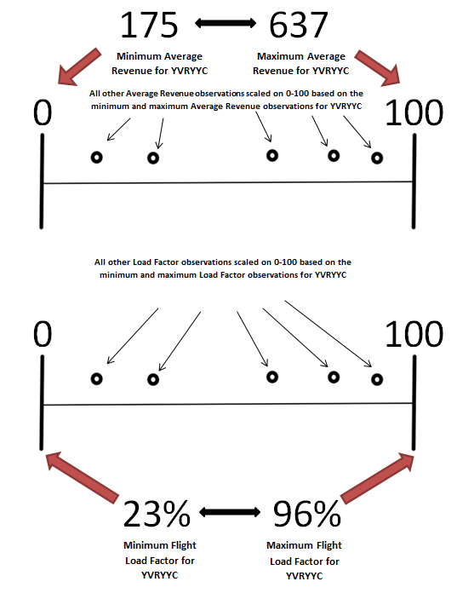
Data Selection - Standardization
Data Standardization represents a crucial part of the process.
Using variables with different scales can hinder clustering results
Standardizes the breadth differences between the maximum and minimum load factors and average revenues.

Slide 10
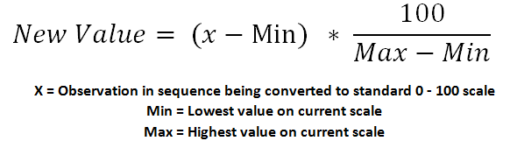
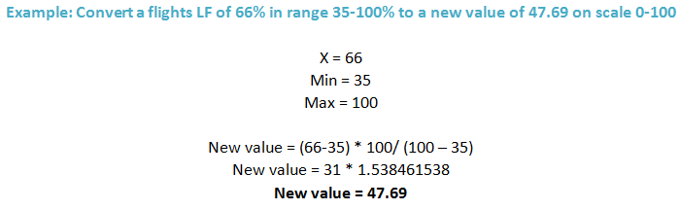
Data Standardization Methodology:

Slide 11
Data Selection – Finalizing Clustering Variables
Initially we planned to use three variables for clustering:
Standardized Average Revenue: To capture performance with regards to a revenue metric.
Standardized Load Factor: To capture demand booking performance.
“NDO_20LF”: To capture booking window for each flight observation
We discovered this was sub-optimal because of the similarity between NDO_20LF and Standardized Load Factor.
Final Decision: Cluster with Standardized Average Revenue and Standardized Load Factor.

Slide 12


Outlier Detection
Most time consuming portion of the project yet very important.
Outliers represent flights performing outside the norm.
Its sub-optimal to define flight patterns using flight data that is not characteristic of the norm
Reasons flight outliers can arise:
We used two different flight outlier detection methodologies.
Data Issues
(Inconsistencies and Inaccuracies)
Special Events
(Example: Hurricanes in September 2017)

Slide 13
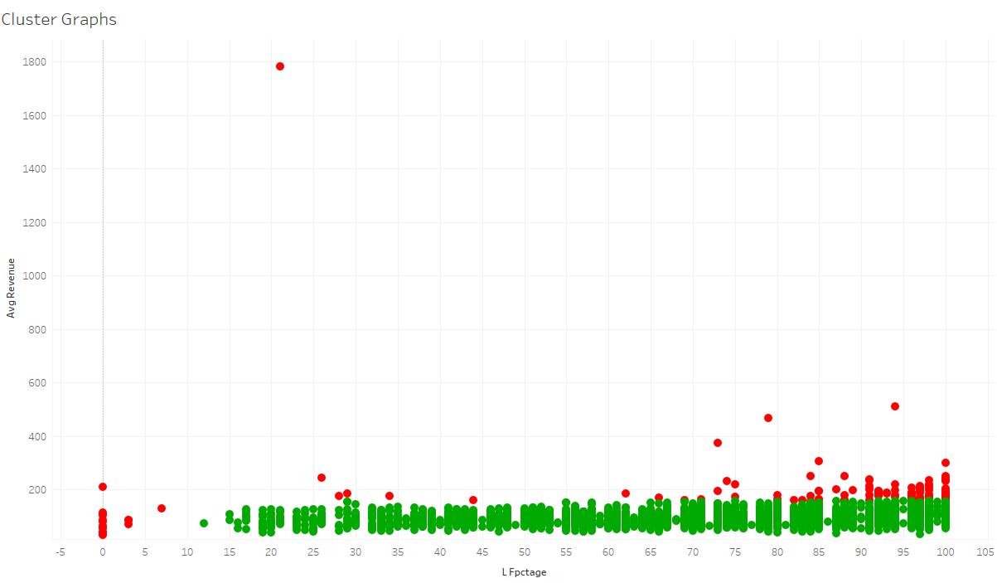
Cluster Graph – With Outliers
Market = YVRYLW
Red Points = Outliers
Green Points = Normal Observations
Image represents cluster graph Pre-outlier removal

Slide 14
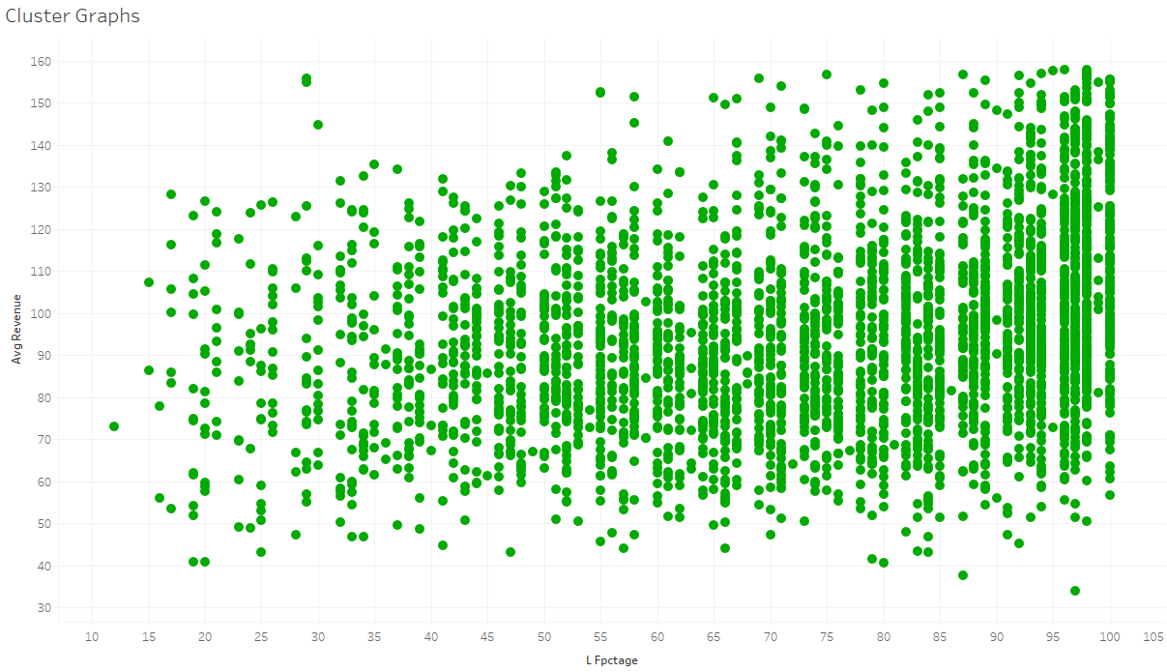
Cluster Graph – Without Outliers
Market = YVRYLW
Green Points = Normal Observations
Image represents cluster graph Post-outlier removal

Slide 15
Outlier Detection – Load Factor Methodology
The logic for removing Outliers in Load Factor was to set a “normal” range.
Set two different “normal” ranges.
Markets with Average Load Factor <50%
Markets with Average Load Factor > 50%
Load Factor
5 – 100 %
Load Factor
10 – 100 %

Slide 16
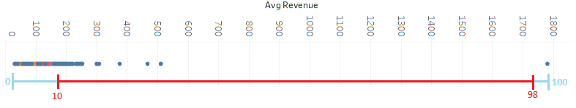
Outlier Detection – Average Revenue Methodology Selection
Interquartile Range Rule:
Lower Threshold = Q1 – (1.5 * IQR)
Upper Threshold = Q3 + (1.5 * IQR)
Anything outside this range is deemed an outlier
Setting a “normal” range for Standardized Average Revenue:
“normal” range = 10 – 98

Slide 17
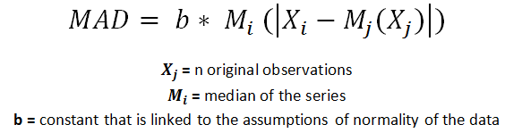

Outlier Detection – Median Absolute Deviation (M.A.D)
Reasons for Selecting MAD
Median is insensitive to outliers and therefore this method provides a way to cautiously remove outliers.
Completely immune to sample size(in our case flight frequency per DirMkt)

Slide 18
MAD Multiplier
The Multiplier is set based on how conservative you want to be with your outlier detection.
Used an iterative method to gradually increase multipliers and ensure we were using a multiplier that didn’t take out too many observations.
Multiplier Value | Number of Markets Assigned to Multiplier Group
2 | 76
3 | 95
3.5 | 140
4 | 94
5 | 101
6 | 59

Slide 19
Clustering Method Selection
Investigated 3 different potential methods for grouping flights
Hierarchal Clustering
PAM
Clustering
K- Means Clustering

Slide 20
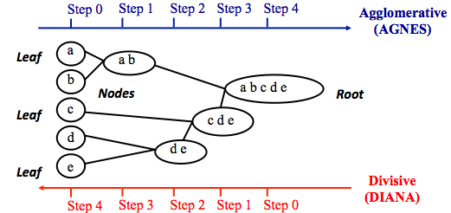
Clustering Method Selection – Hierarchal
Involves creating clusters that have a predetermined ordering from top to bottom or bottom to top.
Two types of Hierarchal Clustering
Agglomerative: works from bottom to top
Divisive: works from top to Bottom
Notes:
Reasons Against Selecting Other Methodologies:
The main reason we decided against utilizing Hierarchal Clustering was for logistics.
Hierarchal clustering is quadratic in the number of Data Objects meaning where n is the number of data objects it is represented as O(n²).
With hundreds of thousands of data observations it would be inefficient to go through hierarchical clustering.

Slide 21
Clustering Method Selection – PAM
Partition Around Medoids.
Goal of the algorithm is to minimize the average dissimilarity of flights to their closest selected flight.
There are two phases
Phase 1(BUILD) = a collection of k flights are selected for an initial set S.
Phase 2(SWAP) = one tries to improve the quality of the clustering by exchanging selected flights with unselected flights.
Notes:
Reasons Against Selecting Other Methodologies:
P.A.M is another partitioning method of clustering and has some similarity to k-means clustering. We decided to go with k-means due to its more simple nature and the presence of a clear methodology to select an optimal k.

Slide 22

Clustering Method Selection – K-Means
Classifies flights in multiple groups, such that flights within the same cluster are as similar as possible.
Each group of flights in a cluster are represented by its “Center”.
The total within-cluster sum of square measures the compactness (i.e goodness) of the flight clustering
Aim is for this value to be as small as possible.

Slide 23
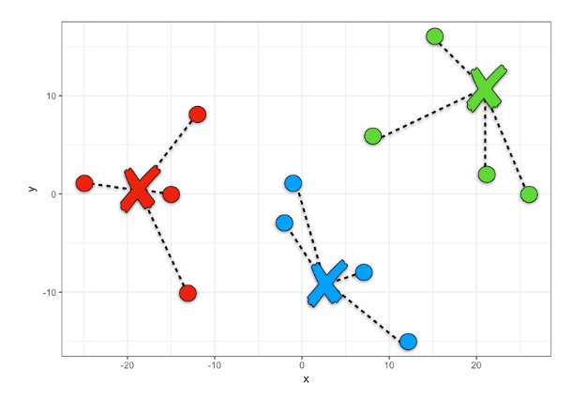
Clustering Method Selection – K-Means Steps
Specify the number of clusters (K) to be created
Select randomly k flights from the route as the initial cluster centers or means
Assign each flight observation to their closest centroid, based on the Euclidean distance between the flight and the centroid flight
For each of the k clusters update the cluster centroid flight by calculating the new mean values of all the data points in the cluster.
Iteratively minimize the total within sum of square
Average Revenue
Load Factor

Slide 24


Clustering Method Selection – Reasoning for Final Selection
Reasons for selecting K-Means
Logical Method for Optimal K selection
Scalability

Slide 25
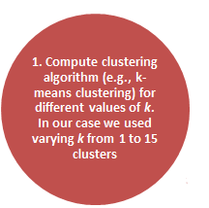
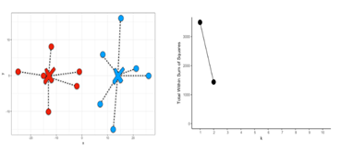
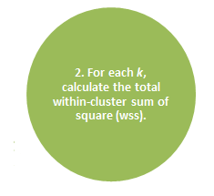
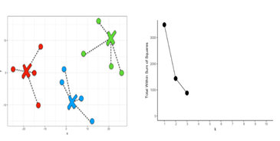
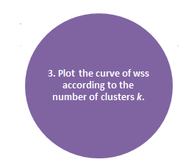
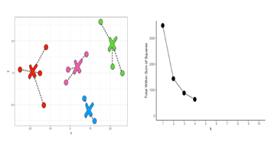
Clustering Method Selection – Elbow Methodology

Slide 26
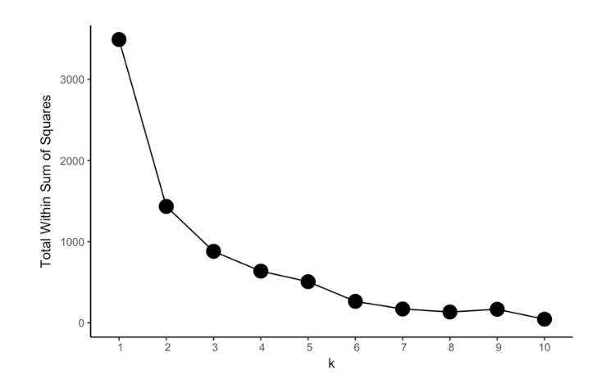
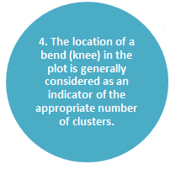
Clustering Method Selection – Elbow Methodology
Final Elbow Plot
“Elbow” or Optimal K Location

Slide 27
Clustering & Review of Results
Reviewing the number of flight cluster groups
Reviewing Load Factor and Average Revenue per cluster per DirMkt
Reviewing the outlier removal process

Slide 28
Reviewing Number of Flight Cluster Groups
Set a maximum of 8 flight clusters that can be assigned to any given DirMkt.
This was done to promote consistency and efficiency.
K | Number of DirMkts Assigned to this K | Average Frequency of DirMkt Assigned to this K
1 | 21 | 8
2 | 38 | 34
3 | 125 | 147
4 | 174 | 317
5 | 116 | 480
6 | 43 | 1438
7 | 39 | 2838
8 | 10 | 4630

Slide 29
Build Graph Construction
Export newly clustered flight data back into SQL
Collect flight data from multiple different NDOs and aggregate key KPIs per cluster
Import Data from SQL back into Tableau for Visualization & Analysis

Slide 30
Build Graph Construction
Number of NDOs Collected | Region/Sub-Region Rule Applies To
300 | International-Sun
 | Transatlantic
 | Hawaii
225 | Florida
 | Arizona
150 | All Other Regions & Sub-regions

Slide 31
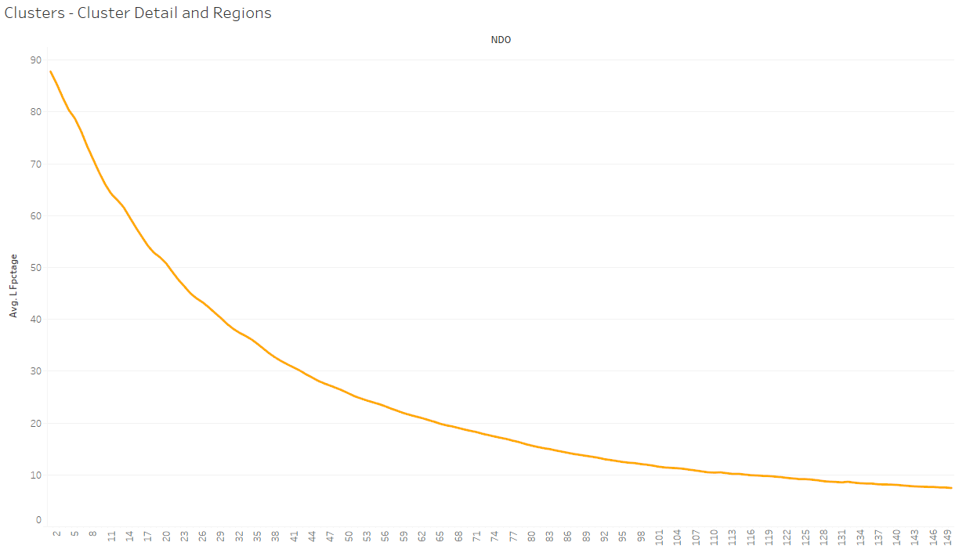
Market = YVRYLW
Curve represents build of average load factor for all flights that were assigned to Cluster 6 for this Market from 150 days out.

Slide 32
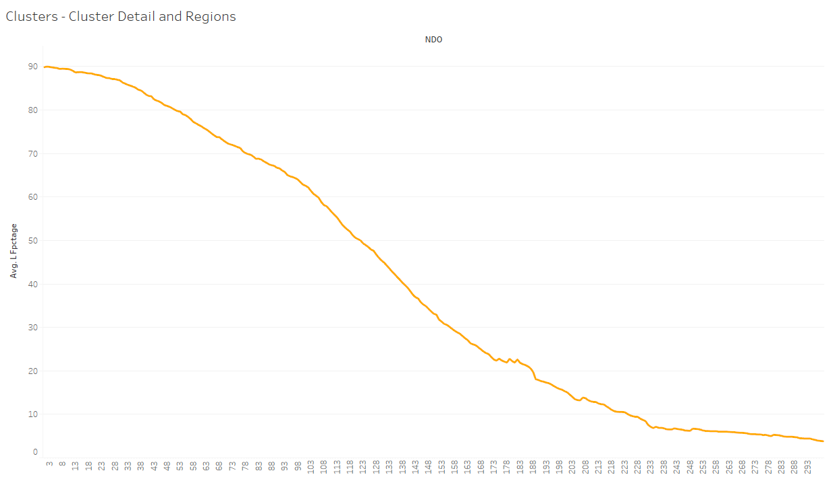
This vertical line is where the data would have been cut off had we not implemented region specific conditions
Market = HNLYYC
Curve represents build of average load factor for all flights that were assigned to Cluster 2 for this Market from 300 days out.

Slide 33
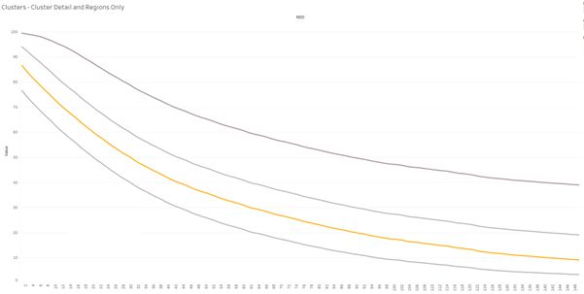
Build Graph Construction – Performance Regions
With the main goal of the project in mind, we have identified performance regions within build curve.
Allow analysts to make dynamic decisions based on a flights location on the build graph.

Slide 34
Build Graph Construction – Performance Regions
Spoilage Region
LF < Cluster Avg -10%
Flights performing poorly.

Slide 35
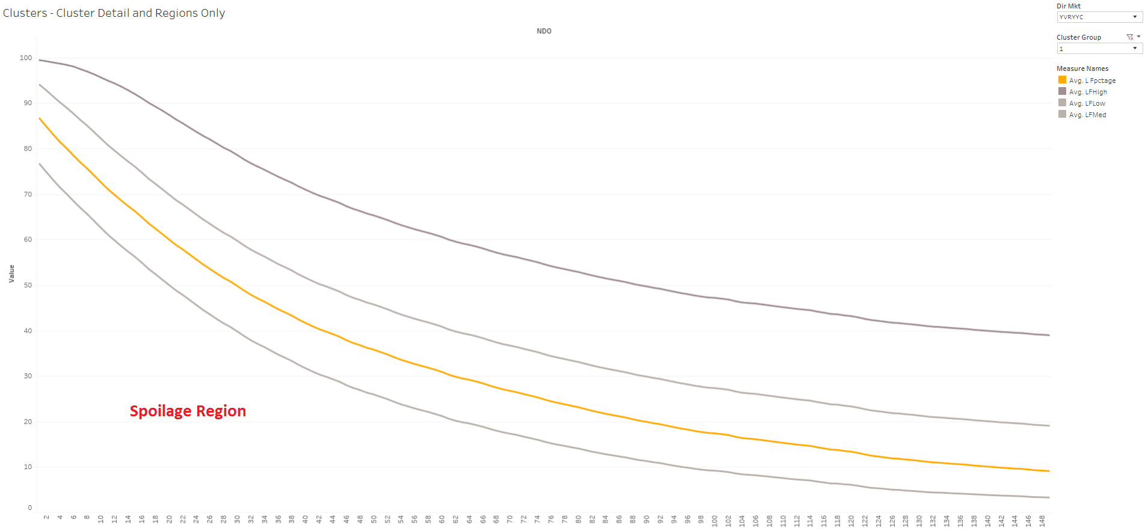
Spoilage Region

Slide 36
Build Graph Construction – Performance Regions
Spoilage Region
LF < Cluster Avg -10%
Flights performing poorly.
In-Range Region
LF between Cluster Avg ± 10%
Flights are preforming as expected.

Slide 37
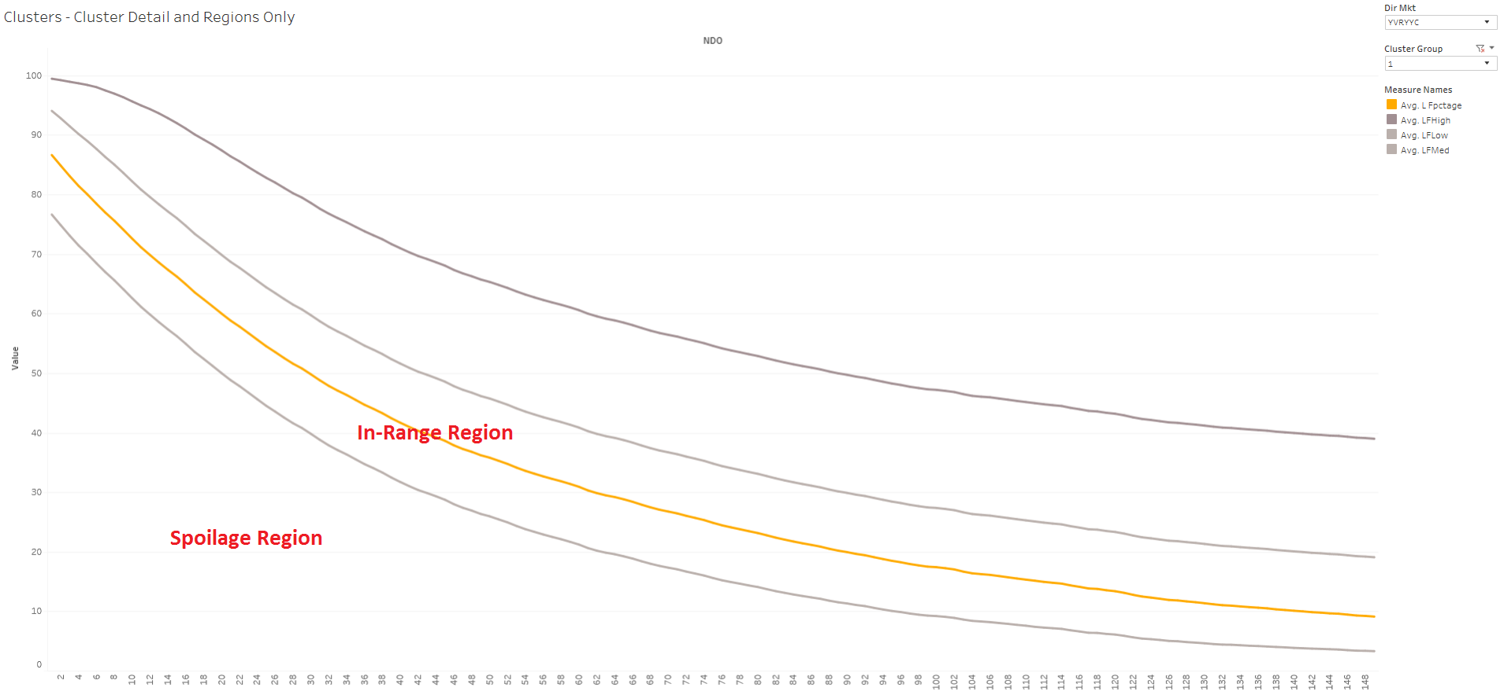
In-Range Region

Slide 38
Build Graph Construction – Performance Regions
Spoilage Region
LF < Cluster Avg -10%
Flights performing poorly.
In-Range Region
LF between Cluster Avg ± 10%
Flights are preforming as expected.
Yield Region
LF between Cluster Avg +10% and +30%
Flights have high opportunity for yield.

Slide 39
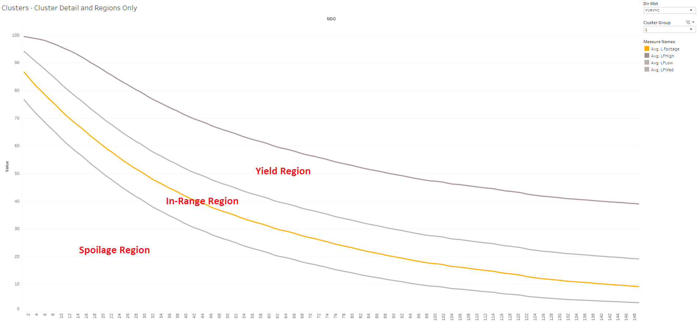
Yield Region

Slide 40
Build Graph Construction – Performance Regions
Spoilage Region
LF < Cluster Avg -10%
Flights performing poorly.
In-Range Region
LF between Cluster Avg ± 10%
Flights are preforming as expected.
Yield Region
LF between Cluster Avg +10% and +30%
Flights have high opportunity for yield.
Spill Region
LF > Cluster Avg +30%
Flights are in Danger of being sold too soon.

Slide 41
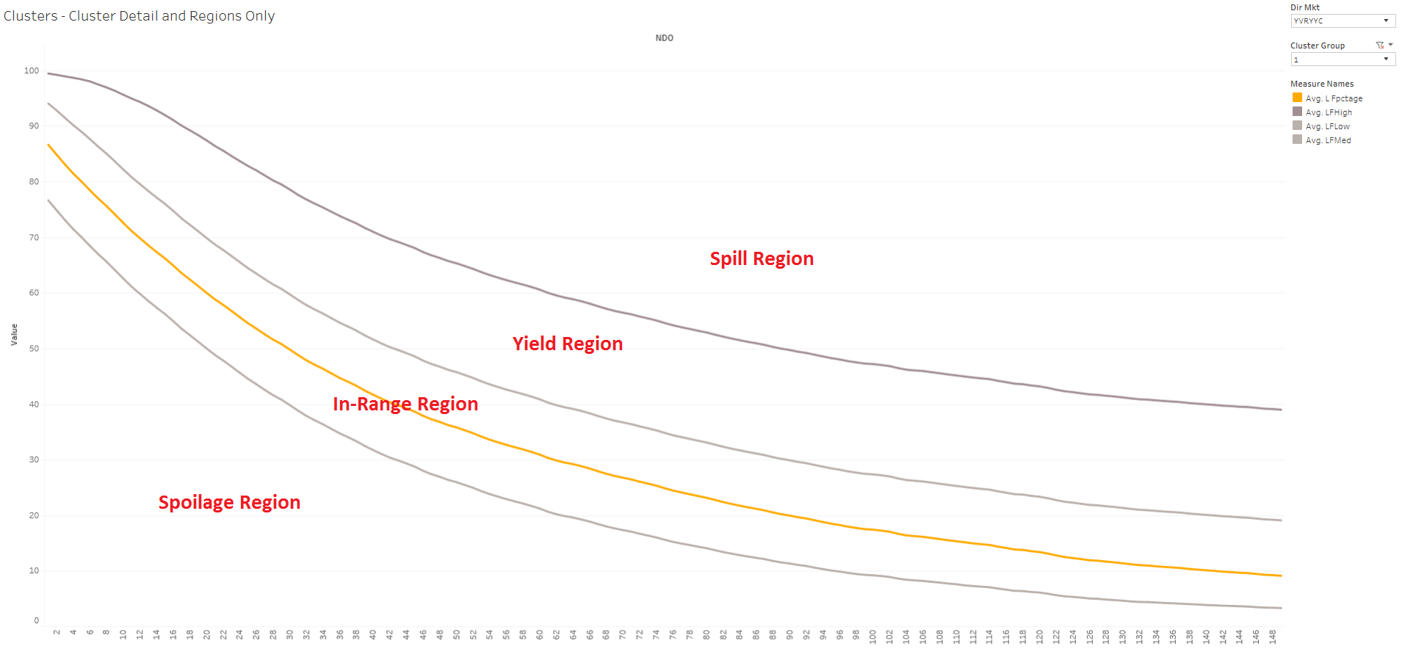
Spill Region

Slide 42
Date Mapping
Date Mapping Process
Step 1: Collect data from all our flights from today to the actual date of the flight in the future.
Step 2: Account for date mapping(taking into account holiday changes) in order to make this comparison accurate.
Step 3: Match flight dates from last year to current year and assign future flights to the appropriate cluster group.

Slide 43
Project Implications - Limitations
For markets with low frequencies, it’s very difficult to create cluster groupings.
Not removing outliers from markets with less than 35 flights.
Otherwise there won’t be enough data points.
Doesn’t account for Market Condition changes.
Mapping flights based on flight time might not factor in big schedule changes YoY.

Slide 44
Project Implications – Potential Future Developments
Cluster adjustment potential for the analysts to meet performance goals.
Ex. Sold too soon clusters, Lowering Final Load Factor, Raising ending Load Factor goals.
Snapshot feature to capture build of the future flight and interaction with the regions.
To see effect of analyst adjustments over time.
To measure KPIs based on flight performance (Ex. % days per region)
Definition of performance regions could be investigated further.
Potentially using standard deviation to make it more route specific
Add more variables to the clustering
Ex. Method to capture guest booking window to the model
Efficiency of the code used to conduct the clustering portion of the tool could be improved in order to allow quicker data manipulation.

Slide 45
Questions Section

Slide 46
Appendices

Slide 47
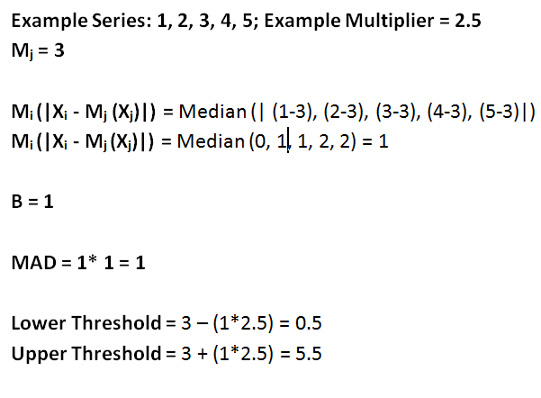
MAD Example

